Slide 1
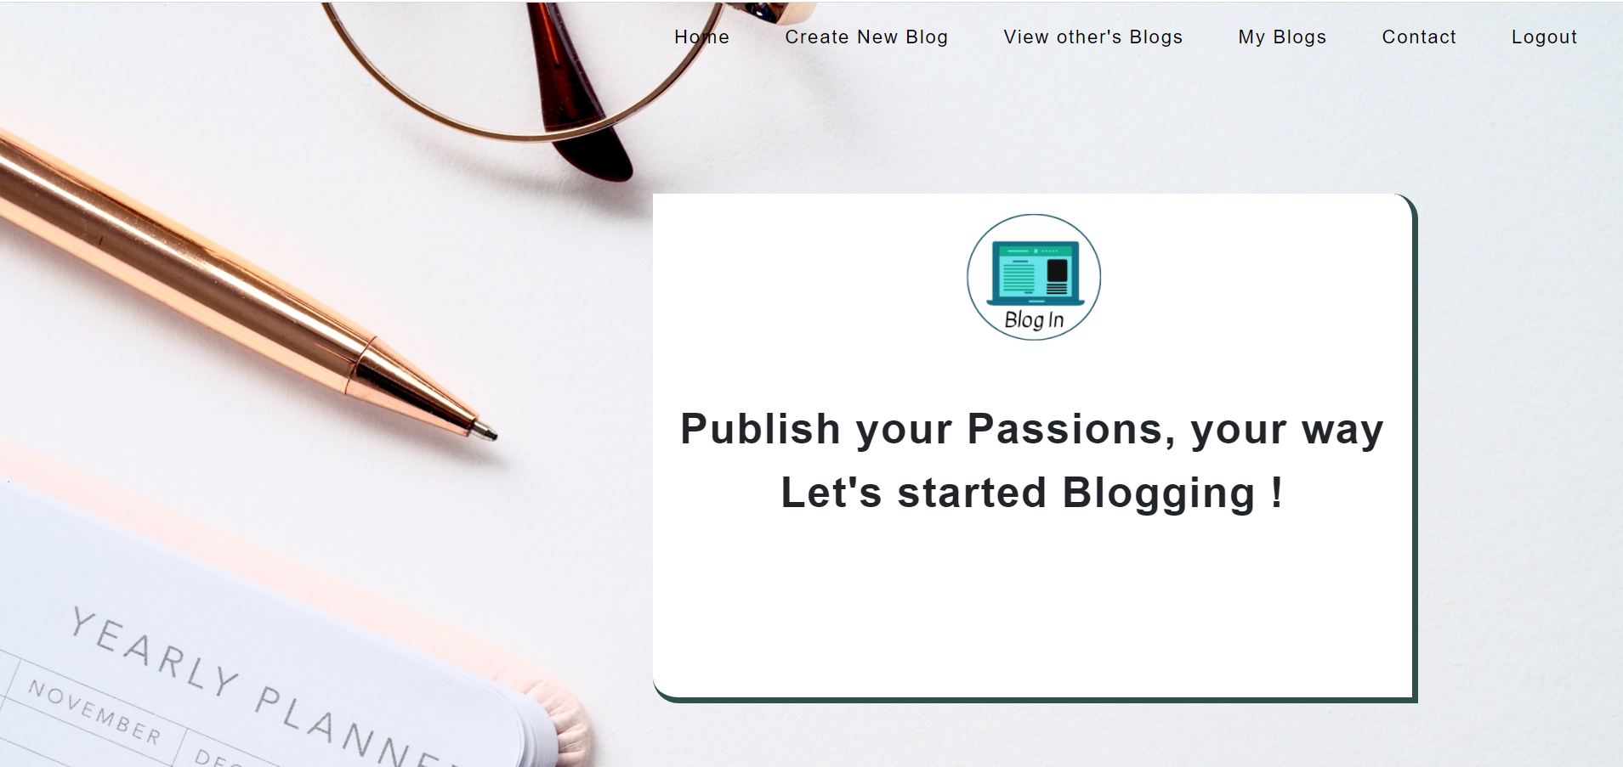
Blog In
Database Management Project for creating and sharing Blogs

Slide 2
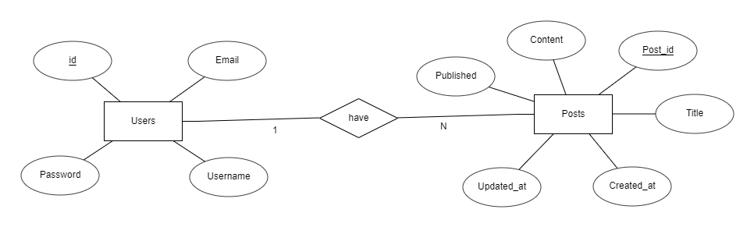
ER Diagram for Blog In

Slide 3
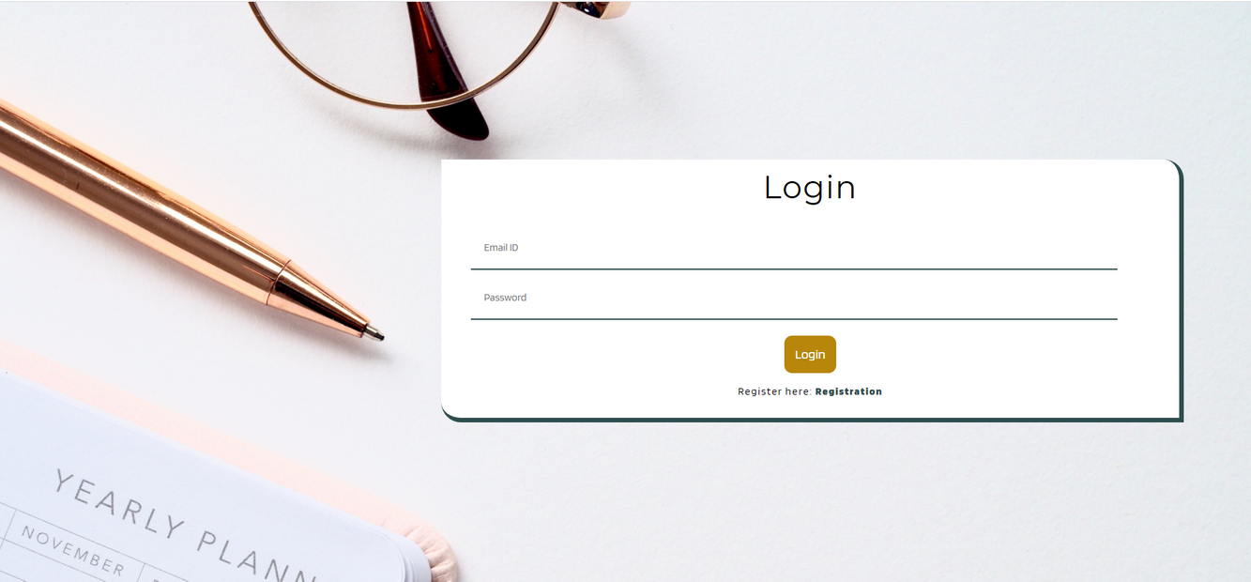
Login
After Login to Blog In, user will be navigating to home page of website, where user can
1) Create New Blog
2) View Other's Blogs
3) View his/her Blogs
Home page

Slide 4
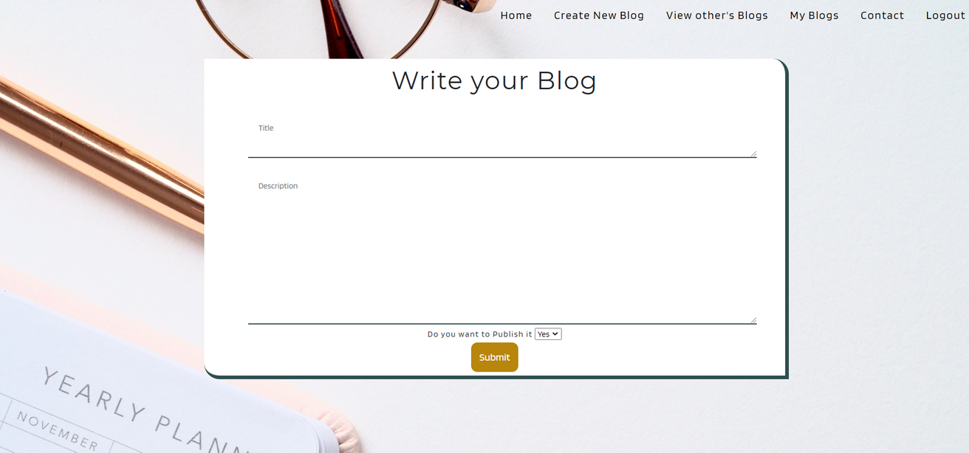
Create New Blog
Here user can create New Blog and also can choose whether he/she want to publlish the blog, (once published any one can see his/her Blog)

Slide 5
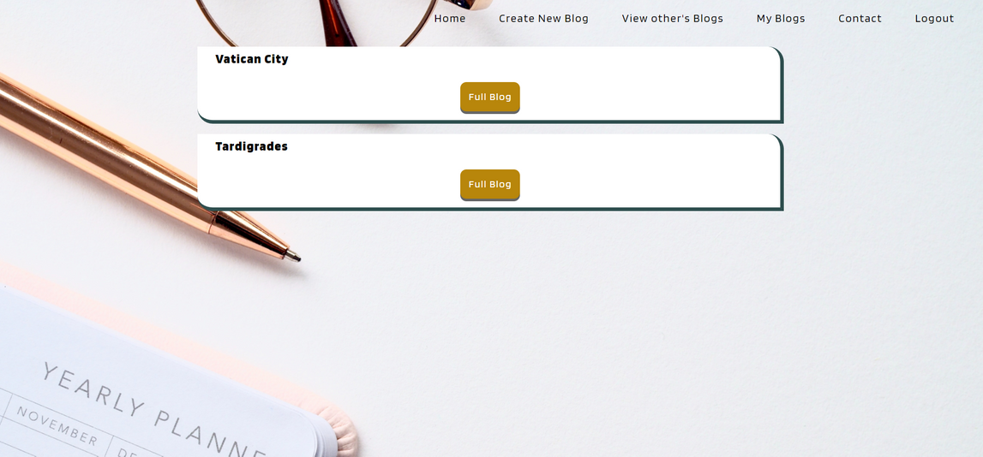
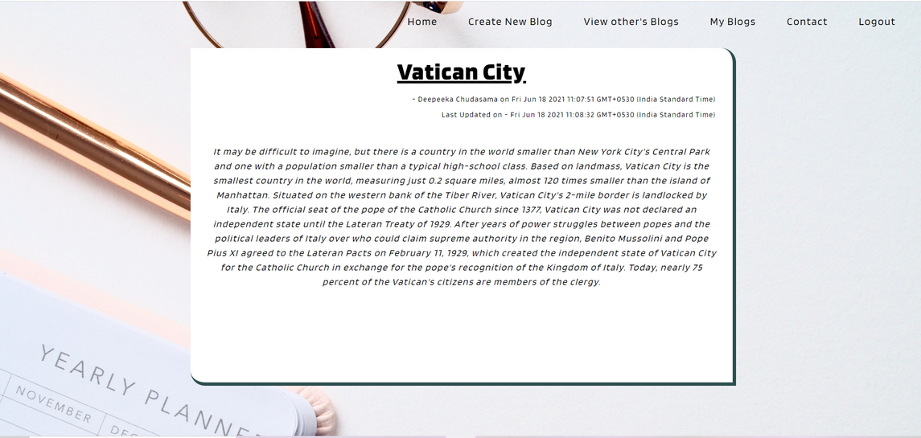
View Other's Blogs
User can view other users Blog as well (but only the published one's)
Full Blog

Slide 6
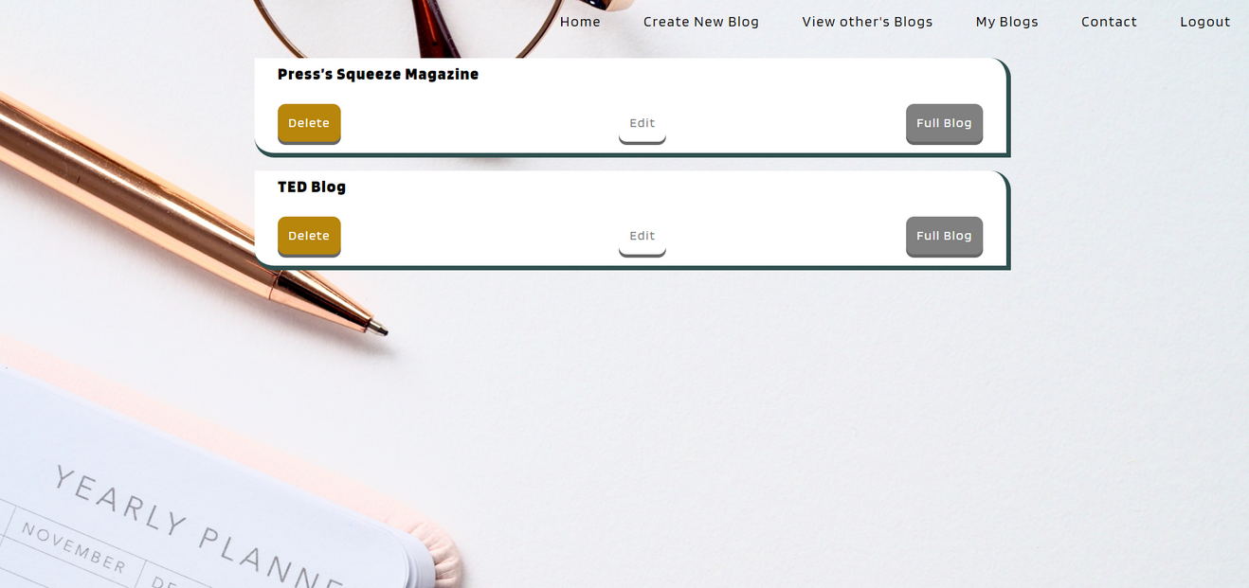
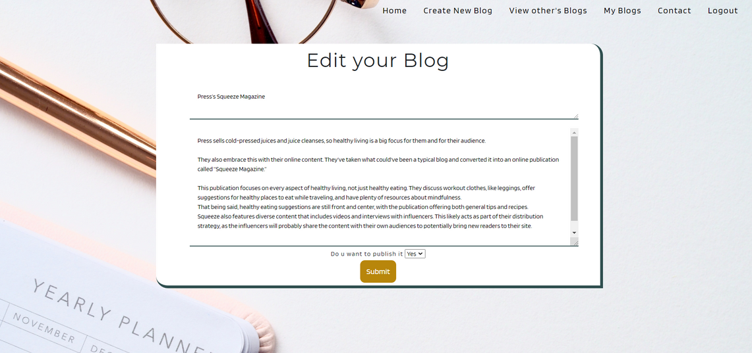
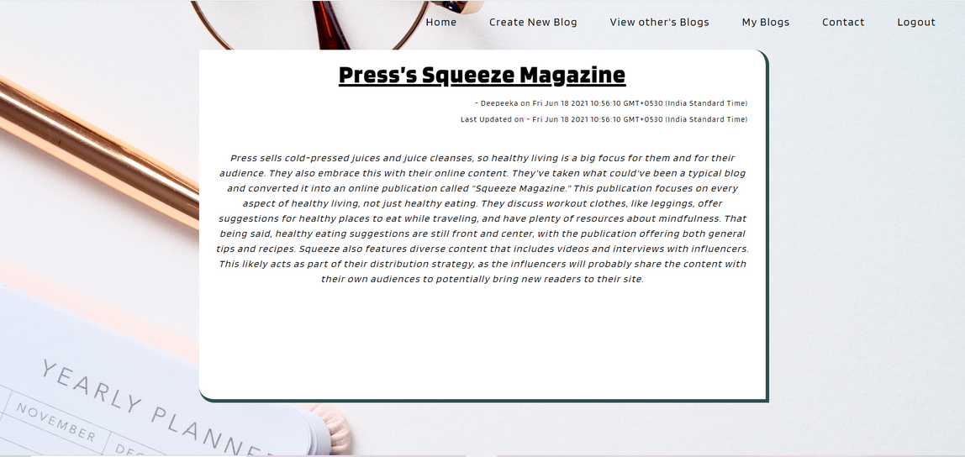
My Blogs
User can view,edit
& delete the Blog
Edit Blog
Full Blog

Slide 7
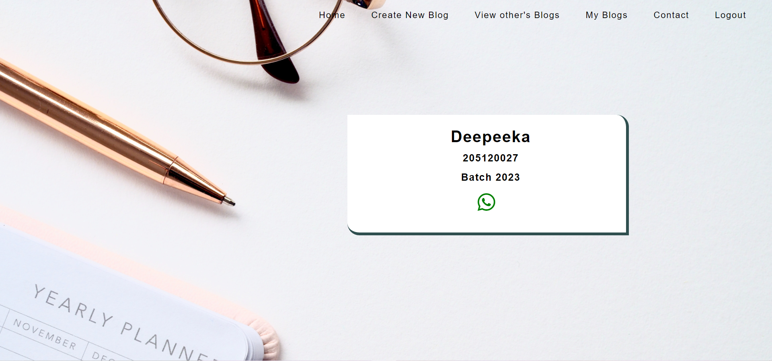
Tech Stack Used:
Database: MySql
Backend: Node.js
frontend: HTML,CSS,js

